Slide 1
NCTU DL Lab4 - Sequence-to-sequence Recurrent Network
TA 李仕柏
April 14, 2020

Slide 2
Outline
Lab Objective
Important Date
Lab Description
Hints
Scoring Criteria
Notes:
This course is a graduate-level course, which was first offered in spring term of 2017.
It is instructed by two other professors and me.
Back then, about 55 students were enrolled in this course.
In fact, we had a lot more students hoping to take it.
But, we could accept only 60 of them due to limited GPUs we have.
This course was concluded with a workshop in July this summer, with 26 teams presenting their final projects.
In this workshop, we also invited few experts from the industry to grade the students’ performance.
Some of them were amazed by the diversity of the students’ projects.

Slide 3
Lab Objective
In this lab, you need to implement a seq2seq recurrent neural network for English spelling correction.
Spelling correction
E.g. ‘recetion’ to ‘recession’

Slide 4
Important Date
Experiment Report Submission Deadline: 4/28 (Tue) 11:59 a.m
Demo date: 4/28 (Tue.)
Zip all files in one file
Report (.pdf)
Source code
name it like「DLP_LAB4_yourstudentID_name.zip」
ex: 「DLP_LAB4_0756051_李仕柏.zip」
5% penalty to score if you do not follow the format rule

Slide 5
Lab Description
To understand sequence-to-sequence architecture
Embedding function
Teacher forcing technique
Word dropout

Slide 6
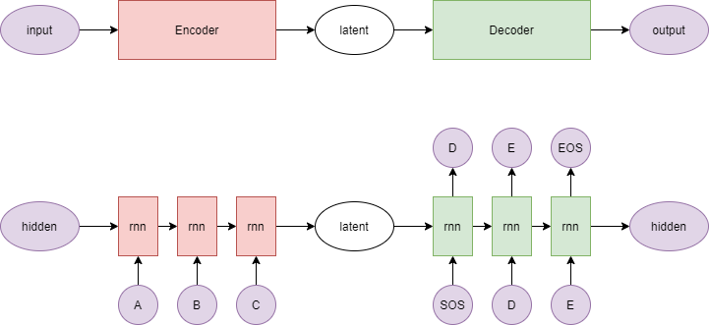
Lab Description - architecture
Input word: ‘recetion’
Output word : ‘recession’

Slide 7
Lab Description – seq2seq
Embedding function (for characters)
[1,2,3] -> [shape(128), shape(128), shape(128)] (high dimensional space)
Teacher forcing
Using ground truth character instead of the output of the decoder.
Word dropout (optional)
Change the input of the decoder to <UNK> token.

Slide 8
Lab Description – Other details
The encoder and decoder must be implemented by LSTM.
The loss function is nn.CrossEntropyLoss().
The optimizer is SGD
Adopt BLEU-4 score function in NLTK.
Average all testing scores
Save your training weights.
While demo, you should load your model weights and run the evaluation to get the results.

Slide 9
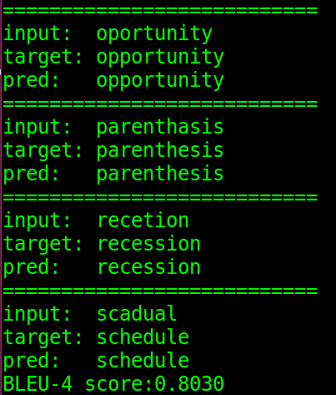
Lab Description – Requirements
Modify encoder, decoder, and training functions
Implement evaluation function and data
Plot the crossentropy loss and BLEU-4 score curve during training.
Output examples:

Slide 10
Scoring Criteria
Report (60%)
Introduction (5%)
Derivation of BPTT (5%)
Implementation details. (30%)
Describe how you implement your model. (encoder, decoder, dataloader, etc.).
You must screen shot the code of evaluation part to prove that you do not use ground truth while testing, otherwise you will get no point at this part.
Results and discussion (20%)
Show your results of spelling correction and plot the training loss curve and BLUE-4 score testing curve during training. (10%)
Discussion of the results. (10%)

Slide 11
Scoring Criteria
Average BLUE-4 scores over all predictions on test.json and new_test.json respectively. (10%+10%)
score >= 0.8 ---- 100%
0.8 > score >= 0.7 ---- 90%
0.7 > score >= 0.6 ---- 80%
0.6 > score >= 0.5 ---- 70%
score < 0.5 ---- 0%
Questions. (20%)

